Slide 1
Probability & Game Theory
Dr. William Hutton
Washington State University
April 8, 2019

Slide 2

Probability Overview
What is the Probability of an Event Happening?
What is the Probability of an event not happening?
What is the probability of all given events happening? (AND)
What is the Probability OF SOME EVENTS HAPPENING? (OR)
What is the probability of event X happening if event Y Happens?

Slide 3
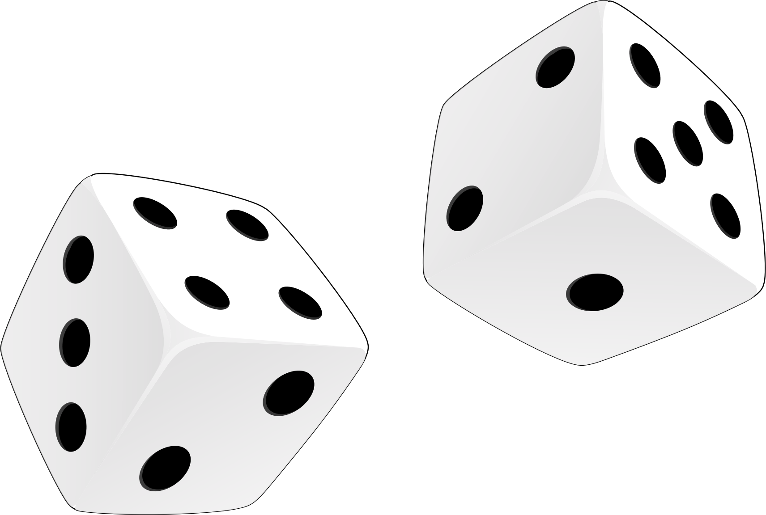
What is the Probability of an Event Happening?
 | 1 | 2 | 3 | 4 | 5 | 6
1 | 2 | 3 | 4 | 5 | 6 | 7
2 | 3 | 4 | 5 | 6 | 7 | 8
3 | 4 | 5 | 6 | 7 | 8 | 9
4 | 5 | 6 | 7 | 8 | 9 | 10
5 | 6 | 7 | 8 | 9 | 10 | 11
6 | 7 | 8 | 9 | 10 | 11 | 12
2d6 Showing | Combinations
2 | 1 in 36
3 | 2 in 36
4 | 3 in 36
5 | 4 in 36
6 | 5 in 36
7 | 6 in 36 (1/6)
8 | 5 in 36
9 | 4 in 36
10 | 3 in 36
11 | 2 in 36
12 | 1 in 36
Notes:
Enumerate each event (red die, blue die) -> purple values showing
Count up each event
Divide by all possible events
May chose to not simplify to compare “apples to apples” (e.g, odss of a 3 or 4 is 1/8 v 1/12)
Reminder: The sum of all event probabilities is 1 (e.g., 36/36).

Slide 4
What is the Probability of an event not happening?
Simple. It is just 1 – P(A)!
What is the probability of NOT rolling ‘7’ on 2d6?
P(7) = 1/6
P(!7) = 1 – 1/6 = ~83%
Notes:
Where P() is the probability of some event ‘A’ happening.

Slide 5
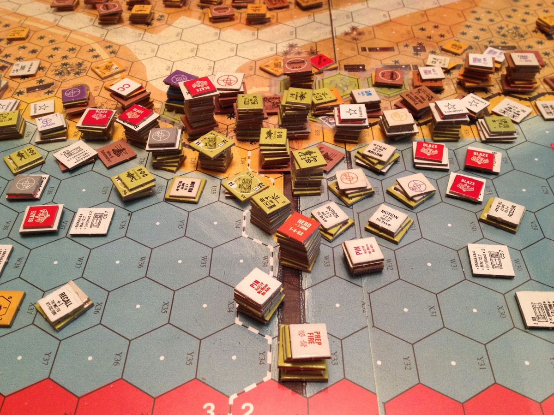
Notes:
”Advanced Squad Leader” is a tactical simulation of squad level (8-12 men) combat. Each turn represents 2 minutes of simulation and can take 1-2 hours per turn to play. Every number on every bit of cardboard has meaning and impact on the probability of different events occurring. The game is played using 2d6 and the P(7) occurring is an important “rule of thumb” for evaluating the chance of something good or bad happening. The rule book weights 7 pounds!
Military originated “table top simulations” to evaluate “what if” scenarios. Now cyber security does it, too with exercises like GridEx.

Slide 6
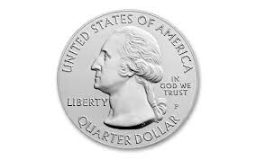
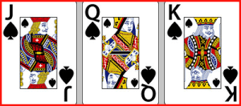
What is the probability of all given events happening? (AND)
If two events are independent (not related), the probability that they will both appear is the product of their respective probabilities.
P(A and B) = P(A) * P(B)
What is the probability of:
Flipping a fair coin and getting ”Heads”, then
Cutting to a “face card” in a deck of cards?
Notes:
P(H) = .5
P(F) = 12/52 = .23
= .115 (A little better than 1:10)

Slide 7
What is the Probability OF SOME EVENTS HAPPENING? (OR)
What is the EXPECTED probability of rolling at least one “1” on 6d6?
P(1) = 1/6
P(1) + P(1) + P(1) + P(1) + P(1) + P(1) = .16667 * 6 = 1
Experiment: Does it always happen?
Security: consider probability of detection and multiple sensors…

Slide 8
What is the probability of event X happening if event Y Happens?
Conditional Probability

Slide 9
Notional security system
a2
.2
a4
.2
a5
.2
.2
a1
a6
.3
a3
.5
Q1: What is the probability the adversary will be detected on the north path?
Q2: What is the probability the adversary will not be detected on the north path?
Q3: Is the north path or south path more vulnerable?
Notes:
Probability of detection from a1 to a2 is .2, so probability of NOT being detected is 1 - .2 = .8. Events are independent. So add (or) or multiply (and)?
Probability of not being detected on each edge is .8 * .8 * .8 * .8 = ~.40 of not being detected on north path.
Q1: .8 or 80%
Q2: .4 or 40%
Q3: North (.40 of not being detected compared to .35 on south path)

Slide 10
GAME THEORY
WHAT IS A GAME?
WHAT CAN GAMES TELL US ABOUT Strategy?
WHAT is the difference between tactics and strategy?
Common Game THEORY CONCEPTS:
Zero sum games
Nash equilibriums

Slide 11
Zero Sum GAMES
A mathematical representation of a situation where one player’s gain is or loss is exactly balanced by the LOSS or GAIN by the other player.
Notes:
So what does this mean for game theory?
Are all contests zero sum games? What about a physical fight? Loss of confidentiality, or nuclear war?

Slide 12
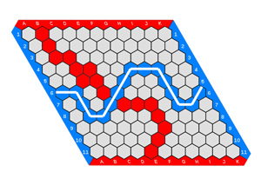
Nash equilibrium Used to analyze outcomes of strategic decisions
A proposed solution to a non-cooperative game
Each player knows the equilibrium strategies of the other player
Each player makes the best decision they can, considering the game state
Every finite game has a nash equilibrium
Notes:
John nash (American Mathematician, 1928-2015, Princeton)
Fundamental contributions to game theory, diff. equations
(“A BEAUTIFUL MIND” w/ Russell Crowe)
Ovierview of the game Hex. Claude Shannon built an analog computer that played the game reasonably well and became the foundation for AI work on the game.
Nash proved in 1950 that the starting player has a winning strategy. 2nd player always loses (if both players play rationally.)
Prisoner’s Dilema (0,-3 or -3, 0, -1,-1, or -2,-2)

Slide 13
”Bluffing in Poker & Nuclear War”
TimeLine
U.S. Uses Nuclear Weapons to end WW II
WW II ALLY BECOMES an EXISTENTIAL THREAT
Secrecy, Espionage, and the COLD WAR
Popular Culture
Dan CarLIN’s “The Destroyer of Worlds” Hardcore History PodCAST (2017)
OLIVER Stone’s “The Untold HISTORY of the UNITED STATES” Series (2012)
WarGAMES (1983)
Notes:
Intelligence, counterintelligence, strategy, mutually assured destruction

